Slide 1
Week 9
Web security, Browsers, VPN, HTTP/HTTPS certificates

Slide 2
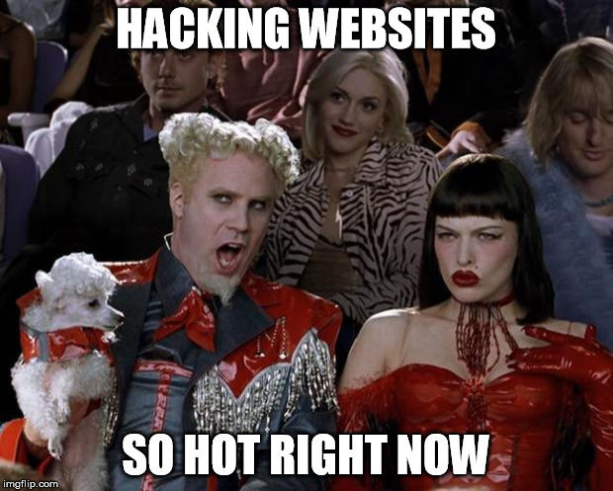
Hacking a Web Site
Injections
  SQL
  HTML
  JavaScript
Leaking Data
Defacing

Slide 3
SQL Injection video
https://www.youtube.com/watch?v=PB7hWlqTSqs&t=568s

Slide 4
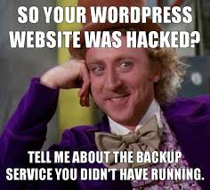
Protecting a website
Updating
Frameworks
Apps (WordPress) and addons
Securing pages and uploads
Inputs and files

Slide 5
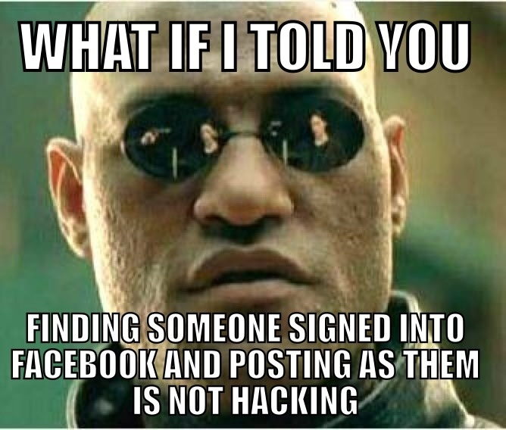
Client side attacks
Sniffing
Tracking cookies
  Supercookies
Browser Fingerprinting

Slide 6
Client side defense
Browser settings
Privacy Mode
TOR
HTTPS always
Blocking cookies
Blocking JavaScript

Slide 7
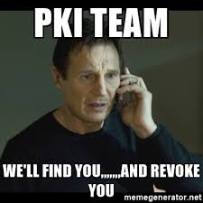
HTTPS and certificates
What is HTTPS?
What is a certificate?

Slide 8
Certificates
Certificate authorities
  For profit
  Non-profit
Authenticating users
Trusted certificates
DigiNotar
Comodo
Revocation

Slide 9
Certificates in the News
Entrust (2024): Chrome stopped trusting its certificates after years of compliance failures
  Source: Google Security Blog
Shorter certificate lifetimes: 200 days from March 2026, and 47 days by 2029
  Source: CA/Browser Forum
Short lifetimes mean renewals have to be automated, for example with Let's Encrypt
  Let's Encrypt

Slide 10
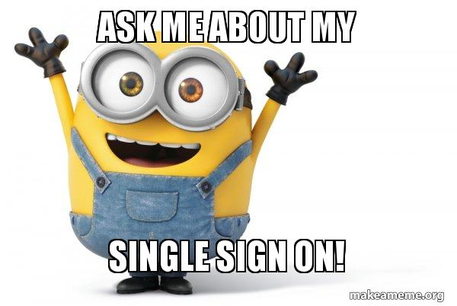
Single sign On
Reduce password fatigue
Reduce IT costs and time spent doing authentication
“Keys to the Castle”
Should include 2 factor authentication
Censorship in other countries blocking the 3rd party

Slide 11
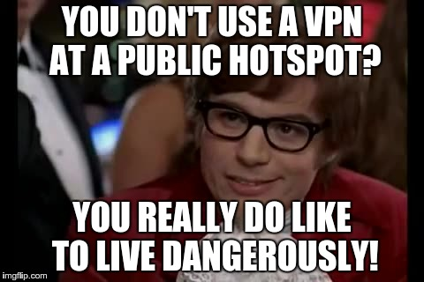
VPN
What is a VPN?
Why would we want one for business?
What about for a consumer?
What are some risks of a VPN?
What are some less known benefits of a VPN?

